Slide 1

Summer at Artemis
By:
Nancy Nghe
2002

Slide 2
Lessons we did during our time at Artemis!
Lets go!

Slide 3
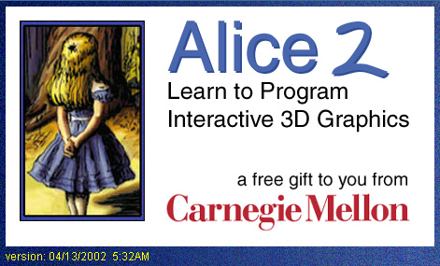
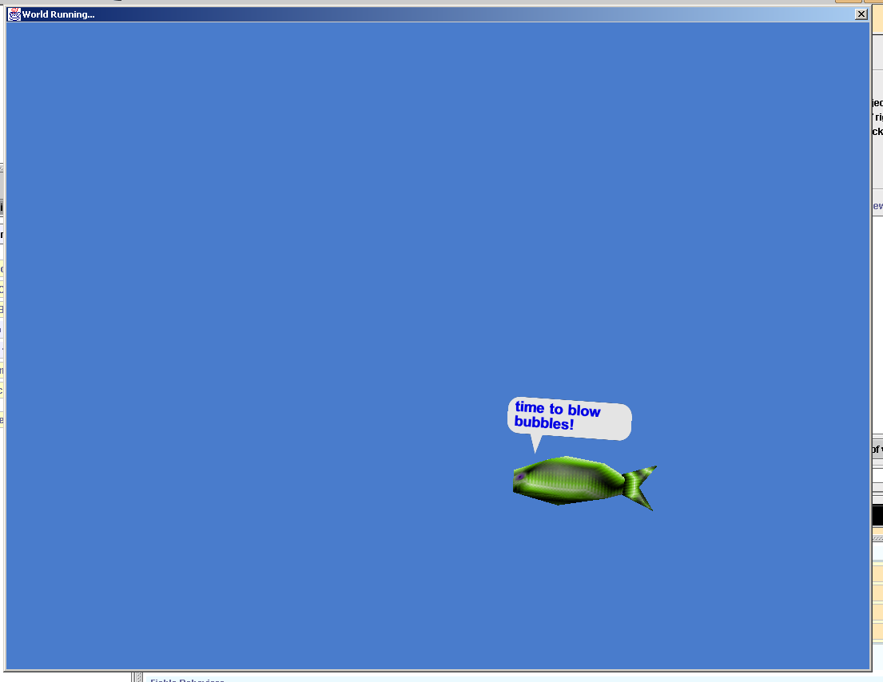
During our time at Artemis we worked on a program called Alice. We animated computer graphics to do what we want them to do. Making them talk, walk, and so on.
Working on Alice

Slide 4
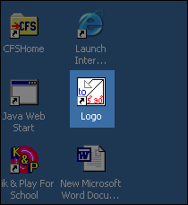
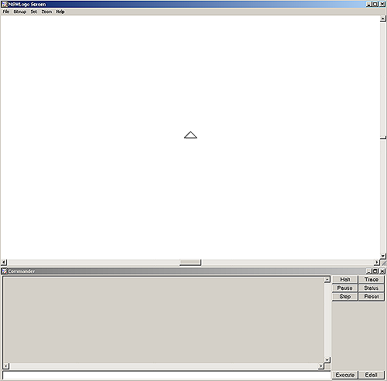
We worked on logo a lot while we were at Artemis. We learned how logo could be used for programming (robots), which we would need in order to make our robots move. We made many different designs using logo, which could be found in our logo books!
Working on Logo

Slide 5
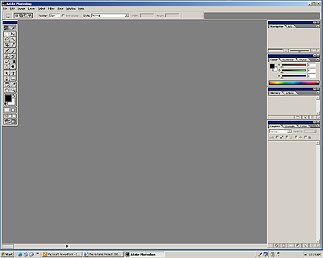
For editing our pictures we used Adobe Photoshop. We used adobe Photoshop to create our nametags. Our binder covers, and of course for our web pages.
Working on Adobe

Slide 6
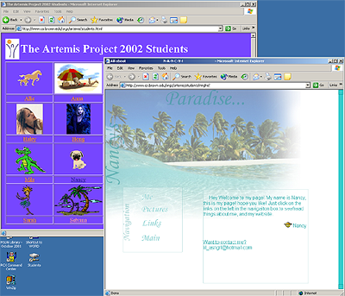
Web pages, everyone loved making. This is my webpage. We learned the basics of HTML and used it, to create a webpage of our own
Webpages!

Slide 7
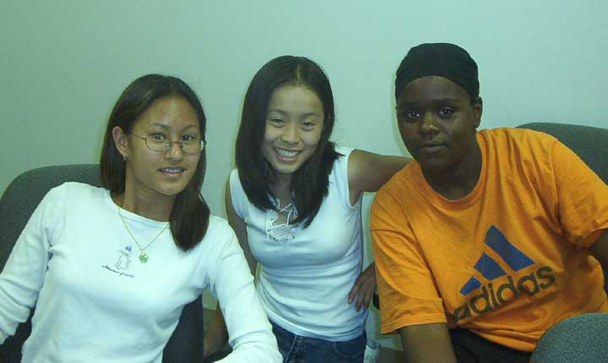
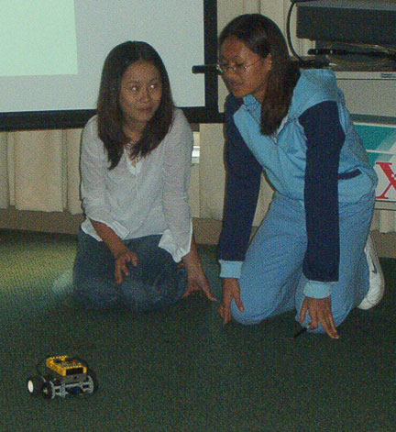
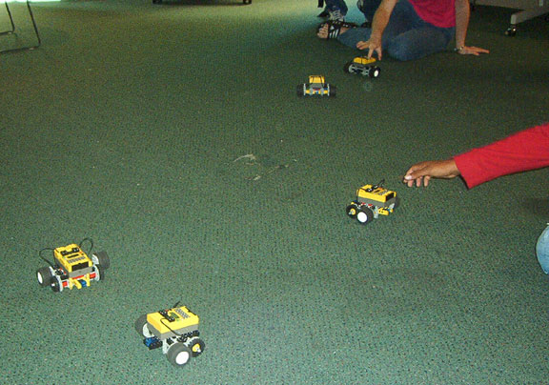
For one of our lessons, we programmed robots to dance. Our outcome was a dancing robot called “Snuggles”!
On the right is my group!
On the bottom is everyone’s robots and on the bottom is our robot Snuggles dancing!
Robot Dance Show

Slide 8
Places that we went!
And things that we did outside of the CIT
Next! ->

Slide 9
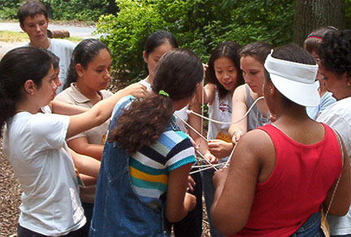
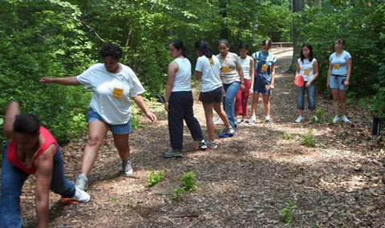
At the ropes course, we learned to work as a team. Here is my team “team yellow” yeah yeah, very original… The picture on top we were trying to figure out how to untie the “human knot”. And below is my team trying to cross the “hot chocolate river”.
Ropes Course

Slide 10
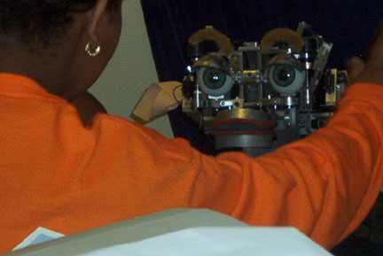
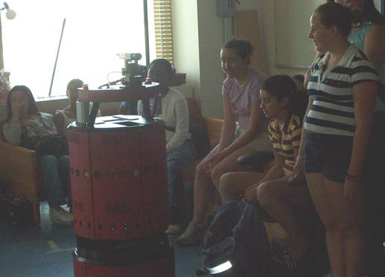
In these pictures we were at the AI lab. At top there is Kismet. And at the bottom that robot is “big red”. We don’t have any pictures in the MIT museum sadly ☹
MIT and AI lab

Slide 11
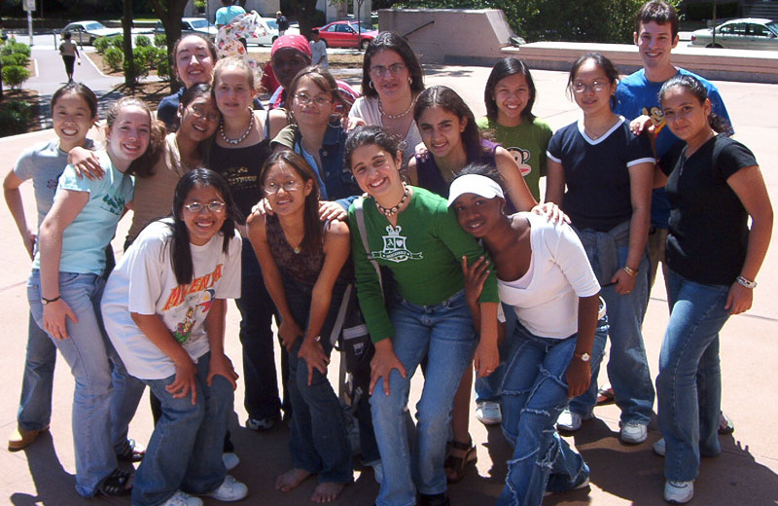
On this day we played different improv games. Such as the animal game, and concentration.
Day with Lance

Slide 12
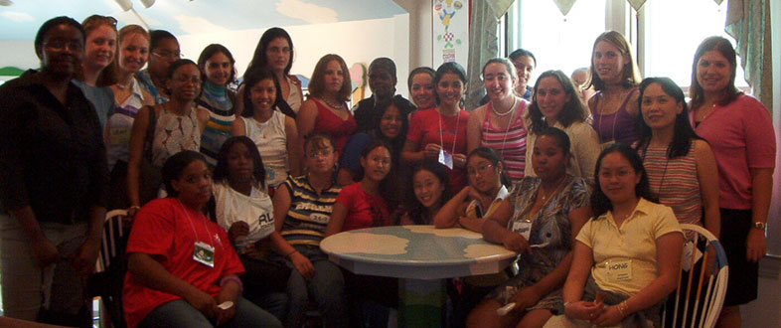
Artemis
Everyone at Ben & Jerry’s
2002

